Slide 1
Common problems in clinical teaching
&
Clinical teacher
SP Rao
Dean
Narayana Medical College, Nellore

Slide 2
Contents
01
02
03
04
05
Reflection & Clinical Teacher
Adhoc Teaching
Teaching Different Students
06
Engaging Reluctants
Clinical Teaching Skills
Evaluation
&
Feedback

Slide 3
Reflection
&
Clinical Teacher

Slide 4
Balance between Service & Teaching
Increased time
No additional incentive
Focus Clinical Reasoning Vs Textual
Learn what learner already knew
Encourage Reflection
Provide Feedback

Slide 5

Active
Experimentation
Concrete Experience
Kolb’s learning process cycle
Abstract Conceptualization
Reflective
Observation

Slide 6
If similar situation arise in future, course of action
Active
Experimentation
Concrete Experience
What has happened?
Kolb’s learning process cycle
Reflection
What was before, and what is now? Explain difference
Abstract Conceptualization
Reflective
Observation
Analyze and review. What could have been done

Slide 7


Concrete Experience
Feeling
Accommodating
Feel & Do
Diverging
Feel & Watch
Experience
Active Experimentation
Doing
Reflective Observation
Watching
Transforming
Experience
Grasping
Converging
Think & Do
Assimilating
Think & Watch
Kolb’s Learning Styles
Abstract Conceptualization
Thinking

Slide 8
Adhoc Teaching

Slide 9
Adhoc Teaching
The ad hoc corridor enquiry is likely to be the most common of all clinical teaching encounters
Provides a challenge to the clinician to ensure that the opportunity is not limited by the encounter brevity

Slide 10



Adhoc Teaching
Patient Centered
Focus on Patient Care
No Feedback
Case presentation by the learner may take half of the time
Enquiry by the clinical teacher regarding patient data takes up another quarter of the time
Discussion of the case and plan for patient care utilises the remaining time

Slide 11

One Minute Preceptor (OMP)
1
5
Learner to create a personal formulation of the clinical situation
Commitment
Correct mistakes
Provide constructive feedback with feasible recommendations for improvement
2
4
Helps teacher & learner identify what the learner does & does not know
Probe Evidence
Reinforce correct work
Provide positive feedback that builds professional self esteem
3
Teach general rules
Teaches the learner ‘take home points’ that can be used in future cases

Slide 12
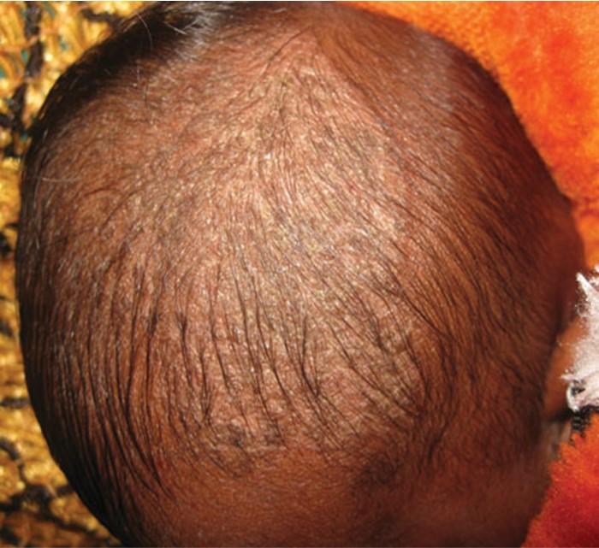

Slide 13
Microskill 1 | Get a commitment | 'What do you think is going on with this baby?’ or 'What do you think the diagnosis is?'
Microskill 2 | Probe for supporting evidence | 'What are the features that support this diagnosis?' or 'What were the major findings that led you to this diagnosis?' or 'What else did you consider?'
Microskill 3 | Teach general rules | 'If this baby had impetigo of the scalp and folliculitis, there would be no greasy dandruff and the lesions are usually localised'
Microskill 4 | Reinforce what was done correctly | 'When considering that diagnosis you appropriately considered the patient’s age'
Microskill 5 | Correct mistakes | 'You could be right that this rash is due to impetigo. However, the use of antibiotics in an 8 week old baby is not desirable, if that was not the case'

Slide 14
Teaching
Different Students

Slide 15
Teaching Students at Different Levels
Environment where everyone can contribute/ ask questions
Foster teaching ethos
Rotate case presenters
Engage whole group
Allow several people to answer same question
Pairing of students

Slide 16

The true aim of every one who aspires to be a teacher should be, not to impart his own opinions, but to kindle minds.
FW Robertson, preacher

Slide 17
Engaging Reluctants

Slide 18
It is frustrating to teach ‘quiet’ students or trainees

Slide 19



Sink or swim attitude
Force reluctant students to contribute
Students embarrassment
Decline attendance/ popularity
Do not provoke upset
Pass over the quiet students
Focus attention on eager to contribute students

Slide 20
Clinical
Teaching Skills

Slide 21
Clinical Teacher- Tips & Tricks
01
02
03
04
05
Be creative
Education Theory
Be creative: try new ideas and approaches to teaching
Increase your knowledge of educational theory
Peers
Volunteer
Log
Talk about teaching with your peers. Learn from their teachings.
Volunteer for an extra role
Keep a log of your teaching

Slide 22
Evaluation
&
Feeback

Slide 23
Evaluation of Teaching
Pay attention to cues
Jot down what worked
Balance interaction learners
Self
Involve non-medical colleagues who focus on teaching methods
Peer
Record teaching for review
Observe Mannerisms
Video Recording
Encourage learners feedback even it is negative
Learners Feedback

Slide 24
Feedback- Sandwitch
01
02
03
Good practice is reinforced
Poor performance is corrected
Path to improvement identified

Slide 25
Feedback- Pendleton
01
02
03
Learner: what was good about his/ her performance
Teacher: areas of agreement and elaborates on good performance
Learner: what was poor or could have been improved
04
Teacher: what he or she thinks could have been improved

Slide 26
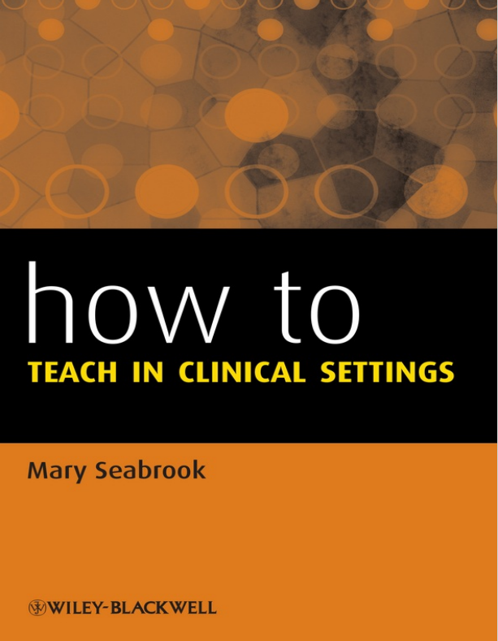


References

Slide 27
Thanks

