Slide 1
PRINCIPLES & STRATEGIES FOR EFFECTIVE CLINICAL TEACHING
Dr V Mahidhar Reddy,
MEU Coordinator,
Prof & HOD,
Dept of General Surgery,
NMCH

Slide 2
WHY RED ?

Slide 3

Medical
Students
Residents
Consultants

Slide 4
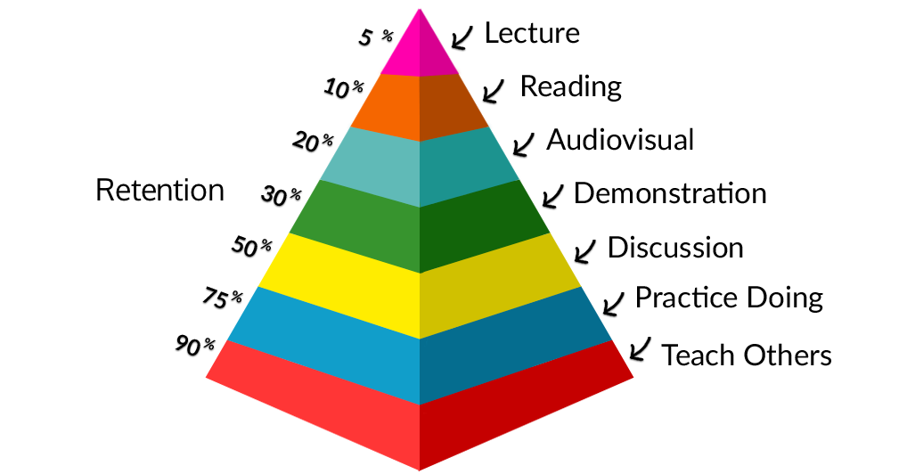

Slide 5
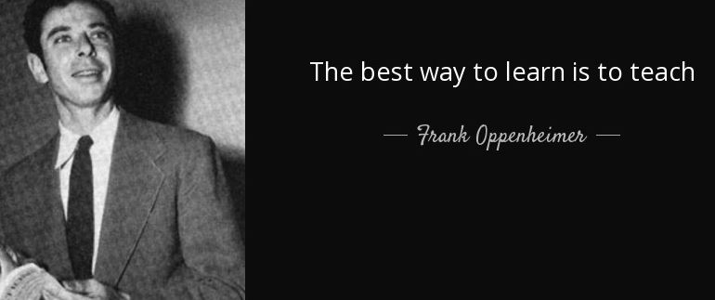

Slide 6
PATIENT CARE
Medical students
Interns
Residents

Slide 7
Are you ready to teach?

Slide 8
The Medical Student Learner
Data gatherers
Memorize a lot
Focus on which decision is ‘right’ or ‘wrong’
Focus on symptoms rather than identifying a disease process
May utilize pattern recognition & analytical thinking
Notes:
Yes, you teach a lot, but an important thing to take note of is the “place” in which your learner is. By doing so, you will be more able to tailor your teaching to the level of the learner. What happens during the course of a student’s education? How does their clinical reasoning evolve?

Slide 9
The Resident Learner
Utilize pattern recognition and analytical thinking
Utilize a weighted decision making process
Focus on which decision is better or worse versus ‘right’ or ‘wrong’
Notes:
Yes, you teach a lot, but an important thing to take note of is the “place” in which your learner is. By doing so, you will be more able to tailor your teaching to the level of the learner. Let’s think about how residents learn. What happens during the course of a resident’s education? How does their clinical reasoning evolve?
Wiese J. Teaching in the Hospital. ACP Press; Philadelphia, PA. 2010

Slide 10
Principles for Effective Clinical Teaching

Slide 11
PRINCIPLE 1: Effortful and challenging learning is durable and results in longterm retention
PRINCIPLE 2: Effective teachers create opportunities for continuous learning, to help students continually develop and acquire skills and knowledge to improve clinical performance.

Slide 12
PRINCIPLE 3: Frequent and regular assessments enhance student learning, capitalizing on the testing effect.
PRINCIPLE 4: Spaced practice and learning is more effective than massed practice..

Slide 13
PRINCIPLE 5: Deliberate practice and learning is effective for improving knowledge or performance.
PRINCIPLE 6: Feedback is very important to facilitate learning and improvement of skills.

Slide 14
PRINCIPLE 7: Interleaved and varied practice maximizes learning in the clinical environment.
PRINCIPLE 8: Advanced organizers activate prior knowledge that facilitates new knowledge integration.

Slide 15
PRINCIPLE 9: Effective learning is multimodal, engaging all learning styles.
PRINCIPLE 10: Schemas are cognitive representations of some knowledge area such as “pulmonary edema.” They are central to the organization and assimilation of new information.

Slide 16
Tools to teach clinical skills

Slide 17
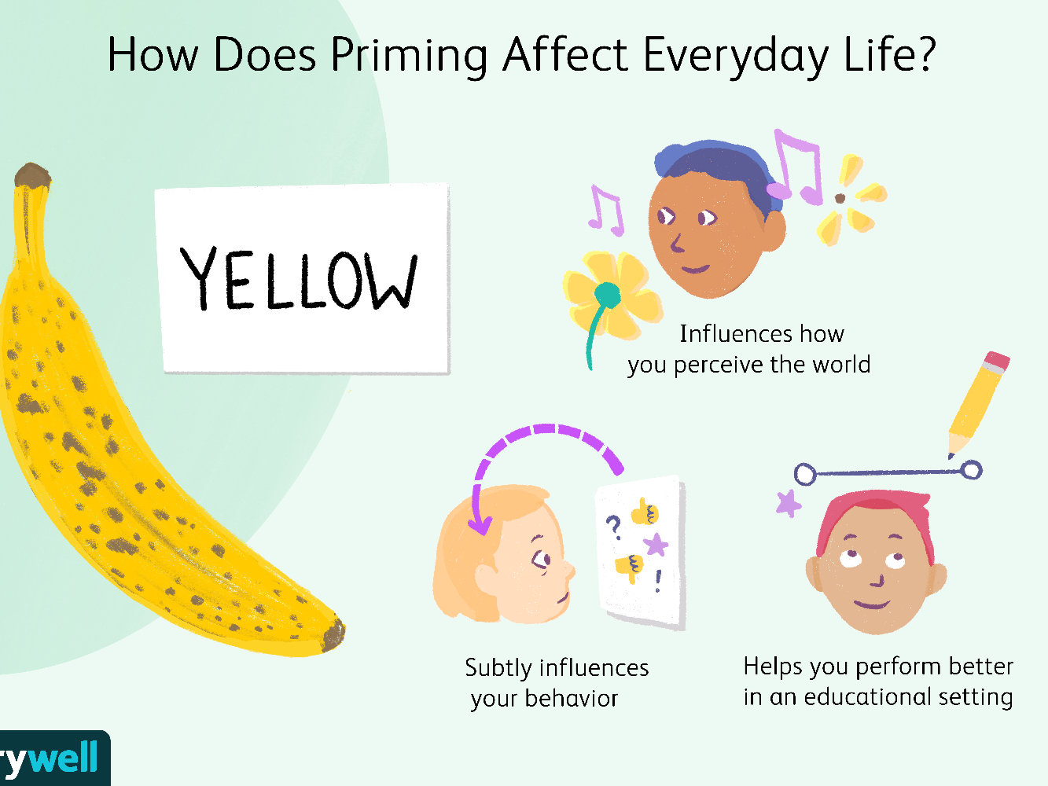
PRIMING

Slide 18

FRAMING

Slide 19
MODELING
Useful time management strategy when you are most pressed for time or the case is too complex for the learner.

Slide 20
Aunt Minnie Approach
Q:- How do you know that woman is your Aunt Minnie?
A:-Because i have seen her before and she looks like her.

Slide 21
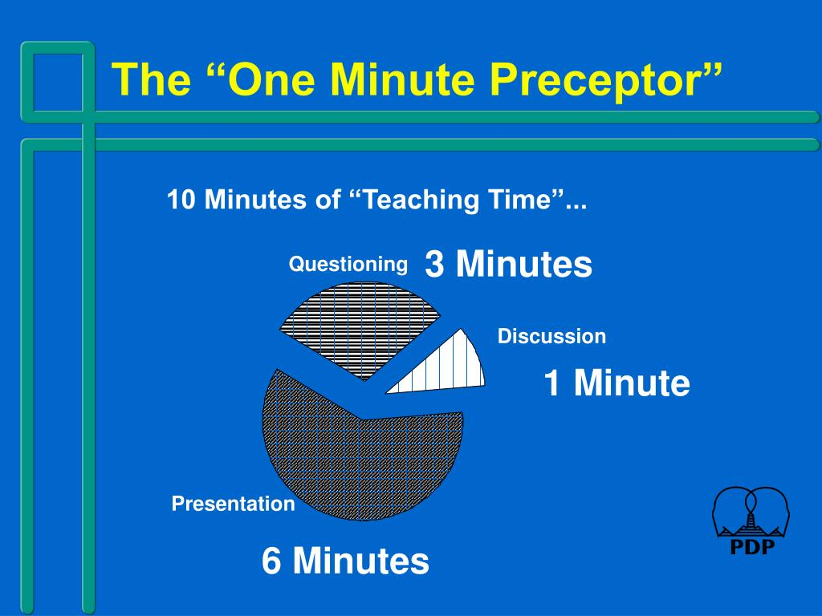

Slide 22
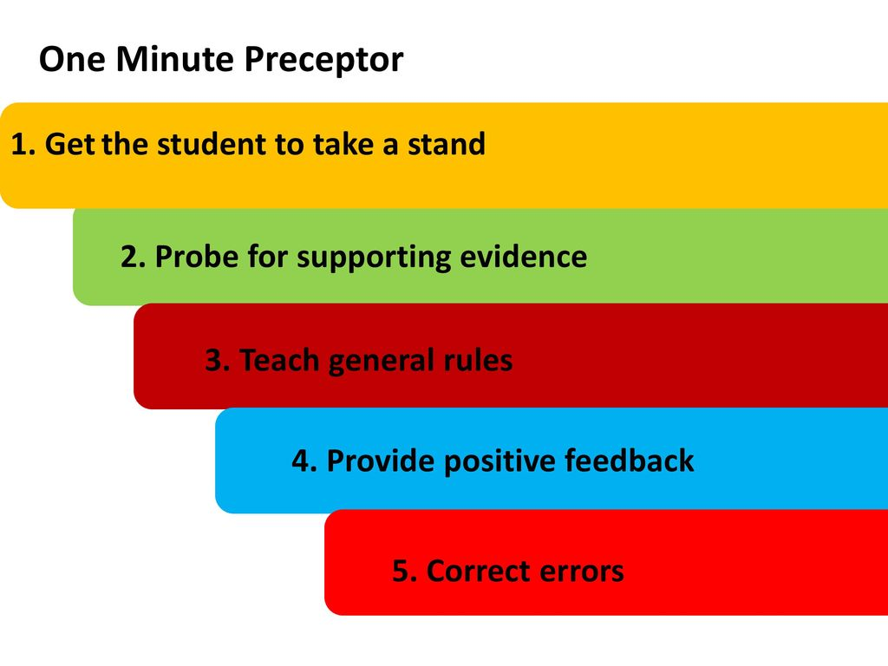
One Minute Preceptor

Slide 23
SNAPPS
Summarize
Narrow
Analyze
Probe
Plan
Select

Slide 24
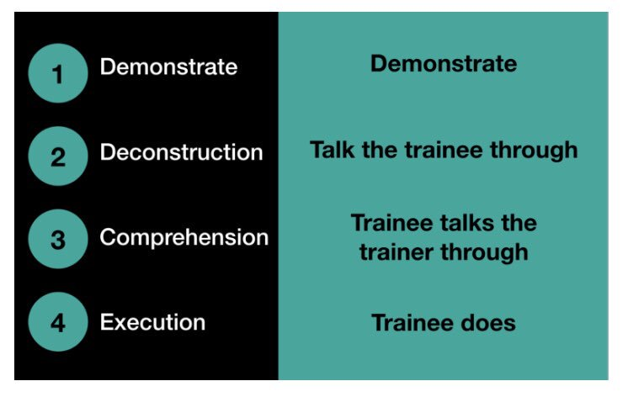
Peyton’s Four Step Approach

Slide 25
Are you ready to teach?
yes

Slide 26


