Slide 1
Teaching in Clinics
DR V KRISHNA CHAITANYA
Professor – Department of ENT
Narayana Medical College, Nellore

Slide 2
Clinical Teaching
Clinical teaching methods refer to the logical course of actions to accomplish particular educational goals in a specific environment in which students can get opportunities of learning outcomes

Slide 3
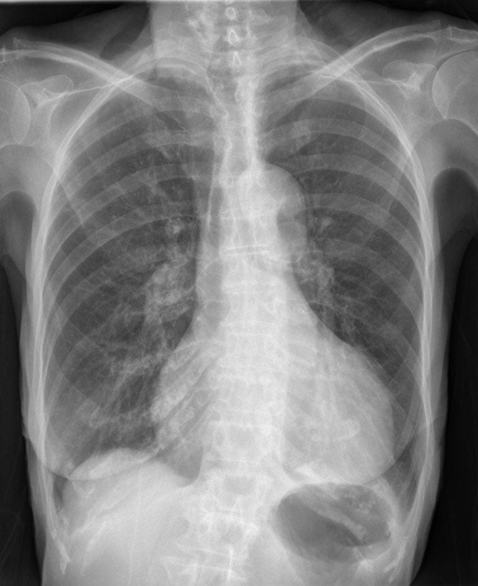
CLASSIFICATION OF THE CLINICAL TEACHING METHODS
Case Studies
Bedside Clinics
Clinical Rounds
Clinical Conference
Demonstration
Process Recording
Clinical Assignment

Slide 4
Teaching in Clinics
“No teaching without a patient for a text, and the best is that taught by the patient himself”
Sir William Osler
Teaching in the presence of a patient.
Teaching should focus on history, Physical examination findings, or psychomotor skills being taught

Slide 5
Teaching in Clinics
Teach in the presence of the patient.
Gives the patient the opportunity to learn
about their disease
Prompts new information from the patient.

Slide 6
Critical time for teaching psychomotor skills
-Diagnostic and therapeutic procedures
-Physical examination skills
-Problem solving skills

Slide 7
Advantages
strengthens learning.
-Use of all senses like hearing, vision, smell and also touch-
Opportunity to learn more about the patient problems directly
eg: Kussmaul respiration
Decreased skin turgor

Slide 8
Advantages
Allows role modeling
Helps preceptors model effective ways of asking questions and demonstrating sensitivity to patient’s comfort and concerns.

Slide 9
Disadvantages
Takes time - additional time
-start using small group
Potential patient discomfort
Requires specific skills and techniques

Slide 10
Patient Comfort Issues
Ask for permission from the patient.
Limit length of teaching session in front of the patient.
Explain all examinations and procedures to the patient.
Make sure the patient understands
all discussions.

Slide 11
Prior Knowledge of Patient Comfort
Find out from the team what portions of the physical exam give them difficulty then discuss and demonstrate proper techniques.
-patient should be appropriately draped and that the patient’s dignity is protected!

Slide 12
Be careful about asking the student or resident who is caring for the patient
a question that they are unable to answer.
- can lead to undermining the patient’s confidence in the team’s knowledge.

Slide 13
Avoid shoptalk.
Using medical jargon without including the patient in the discussion can lead to apprehension in the patient.
-use “education-level appropriate” language

Slide 14
Three Basic Learning Styles
Visual: Learning through watching, observing, and reading Demonstrations, visual examples
Auditory: Learning through listening
Kinesthetic: Learning through doing, practicing, and touching

Slide 15
Clinical Course of Teaching
Practice patient-centered teaching
Teaching what needs to be taught, for sake of patients
Effective teachers do not prioritize disease (what the patient has),
But instead illness (what the patient feels)

Slide 16
Selection Of Clinical Teaching Methods
Teaching strategies in clinical settings are unique
Various members of health team can take part in clinical teaching program such as doctors, Staff Sisters and clinical instructor

Slide 17
Selection Of Clinical Teaching Methods
Based on expected outcomes
Learner Population
Level of Learning
Principles of teaching
Skills of Learning

Slide 18
Case Studies
Most important
Enables the learner to develop analytic, problem-solving, and critical thinking skills
Act independently and make decisions
Commonly followed in clinics these days
Discussion of options is central to case studies

Slide 19
Case Studies
Allows clarification of history and physical in presence of learners
promote learning at more complex levels in both the cognitive and affective domains

Slide 20
Side-by-Side Teaching
Mentor and mentee alternate duties of seeing and examining the patients, writing relevant information in patient’s health record
can observe mentee at work and identify and address challenges

Slide 21
Skills of Mentor
Be able to make his/her own clinical reasoning transparent.
Be able to explain the thought process that leads to a diagnosis.
Be able to explain why a particular course of action is chosen.

Slide 22
Skills of Mentor
Activate the mentee
Promote mentee’s initiative and autonomy
Assess validity of mentee’s presentation
Think aloud To highlight the process of expert reasoning

Slide 23
Role of Mentor
Mentors should not only be teachers
They should lead by example when interacting with and teaching mentees

Slide 24
Role of Mentor in Clinical Teaching
Work as a hands-on role model
Demonstrate responsibility and empathy for each patient, and expect mentees to do the same
Show the clinical utility of physical examination

Slide 25
Role of Mentor in Clinical Teaching
Encourage mentees to be motivated to connect their needs with patients’ needs.
Give enough freedom to the mentee to grow without hurting themselves or patients
Assess the mentee’s acquisition, synthesis, and presentation of clinical data

Slide 26
Role of Mentor in Clinical Teaching
Provide feedback to learners.
- Give both positive and negative
-Both formative and summative purposes

Slide 27
THANK YOU

