Slide 1
TEACHING IN OPERATION THEATRE
DR. BIJU RAVINDRAN
PROF OF ORTHOPAEDICS

Slide 2
CONTENTS
Pre operation theatre teaching
Anatomy of the operation theatre
OT do’s and dont’s
Scrubbing and maintaining sterility
Equipments and Instrumentation
Patient positioning and preparation
Anatomy and approach
Surgical procedure
Closure
Follow up
Teaching in Pandemic situations

Slide 3
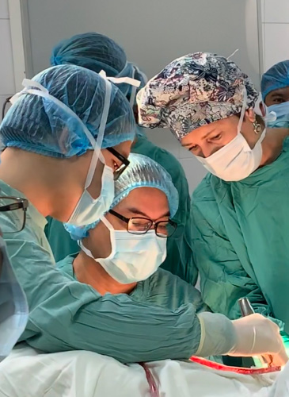
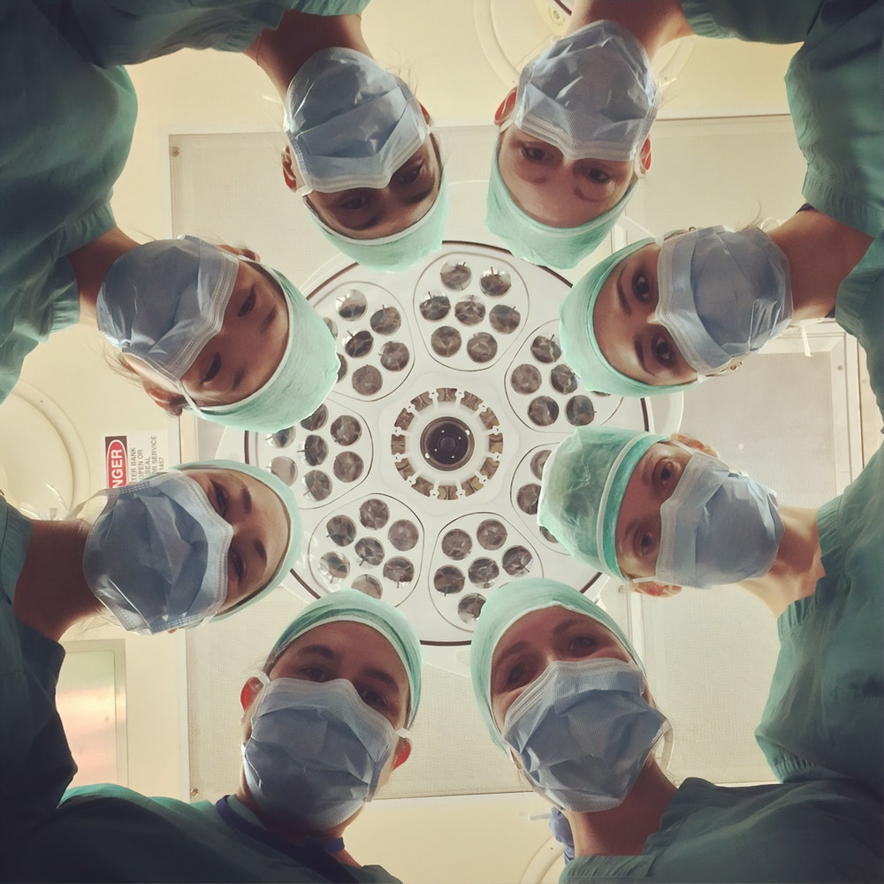

Slide 4
Pre operation theatre teaching
Teaching begins from the day before surgery in the ward
Complete history taking
Examination
Investigations
Arriving to the diagnosis
Pre operative planning
Consent taking
Anatomy of the OT
Surgical procedure in steps
Complications of the proceedure

Slide 5
Pre Entry teaching
Reinforce the diagnosis and the proceedure
OT do’s and dont’s
Maintaining sterility

Slide 6
Pre operative teaching
Begins in the scrubbing area
Reinforce sterility
Movement in the OT
Equipments and Instruments
Patient positioning
Patient scrubbing

Slide 7
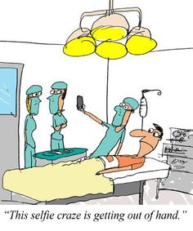
Intra operative teaching
Who will teach ?
Coordination of teaching
Starts from draping
Surgical approach in steps
Closure
Shifting the patient
Also includes attitude

Slide 8
Post operative teaching
Operative notes documentation
Post operative protocols
Follow up

Slide 9
Teaching in pandemic situations
ONLINE MODE / OFFLINE MODES
Small group teaching
Viewing gallery
Pre recorded video teaching
Real time video streaming of the operative procedure

Slide 10
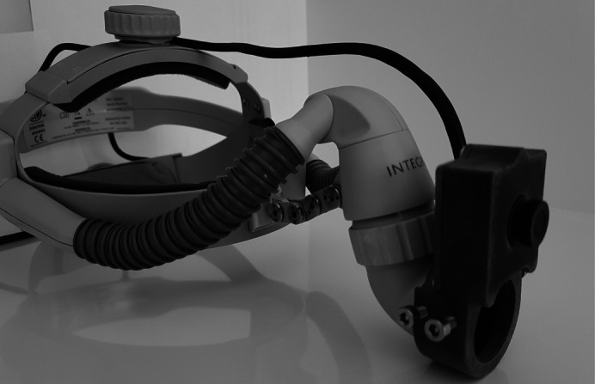
3D printed camera with audio and visual capability was custom designed and developed by Deakin University engineers to fit the headpiece of the surgeon

Slide 11
THANK YOU

