Slide 1
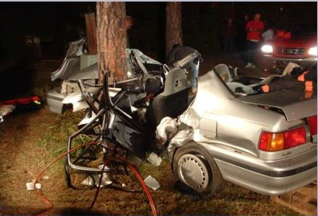
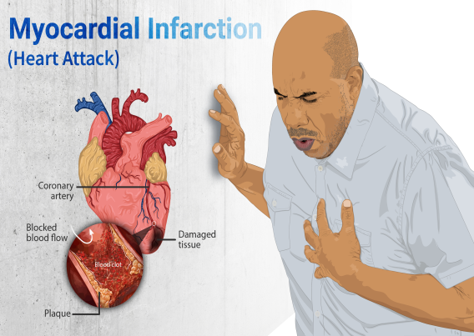
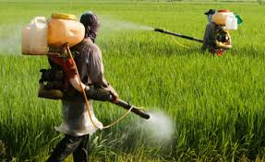

Teaching Accident & Emergency Cases
DR. RAGHU KONDLE
MD, FRCP, FCCM,DipDiab,FIMSA,(PhD)
HEAD OF CLINICAL SERVICES EMERGENCY&INTENSIVE CARE MEDICINE NARAYANA MEDICAL COLLEGE HOSPITAL
RESIDENT AS CLINICAL TEACHER-27-10-1977

Slide 2
Objectives
General principles of teaching in trauma setup.
Triage teaching
Teaching effective usage of Golden hour
Teaching documentation in emergency setup
Useful strategies

Slide 3
Field triage
Pre hospital care and timely transport to nearby trauma setup
ED triage
Resuscitation/Golden hour
Simultaneous Documentation
Re assessment
Disposition
Debriefing
Updating new strategies or protocols

Slide 4
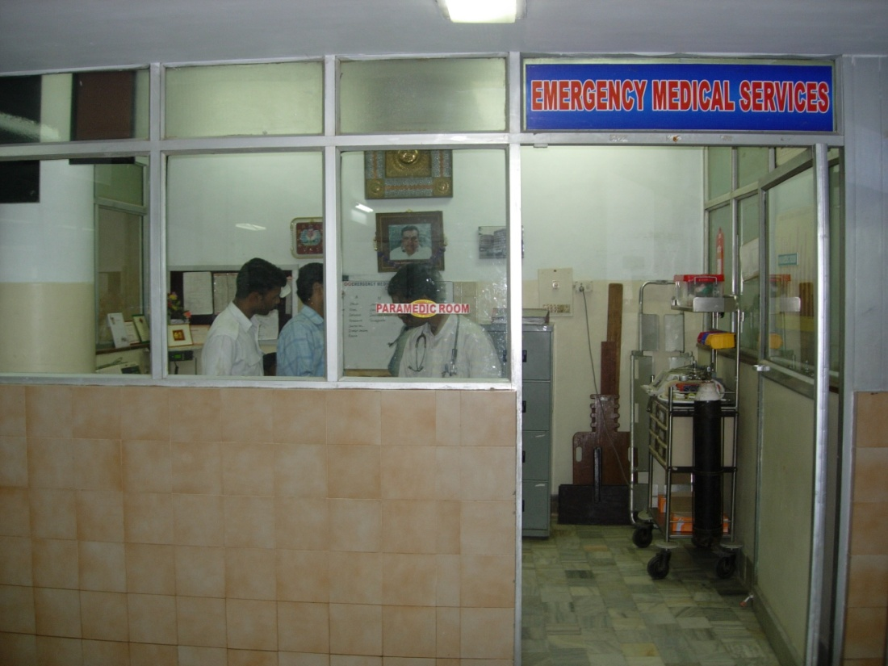
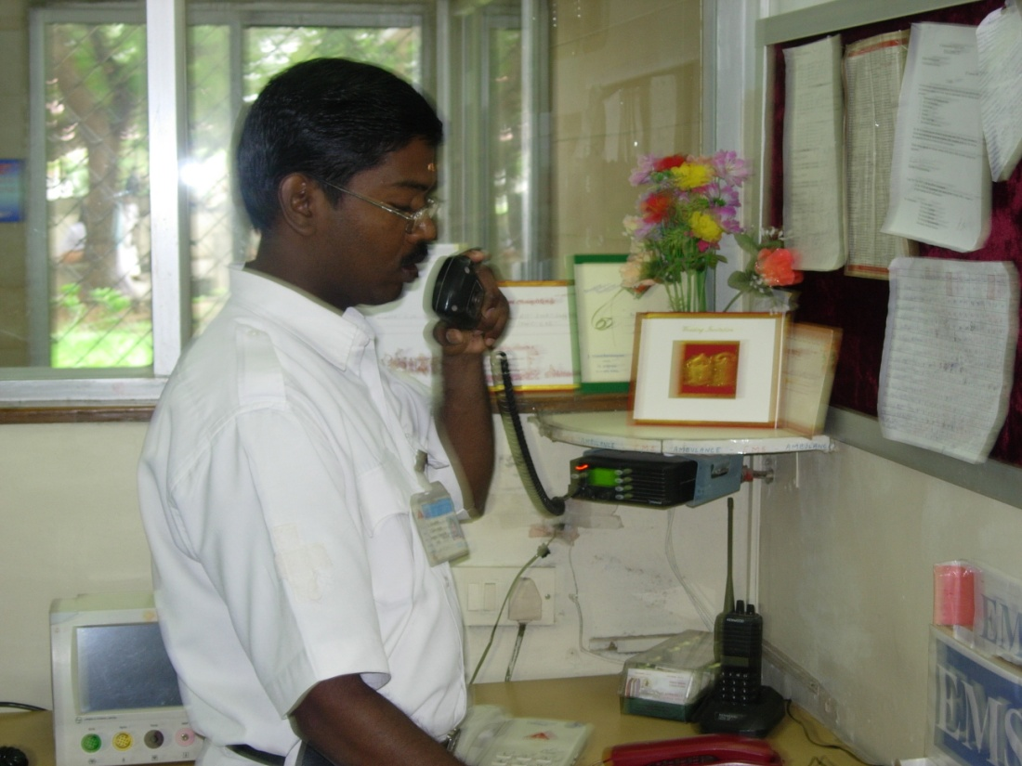
EMERGENCY MEDICAL SERVICES

Slide 5
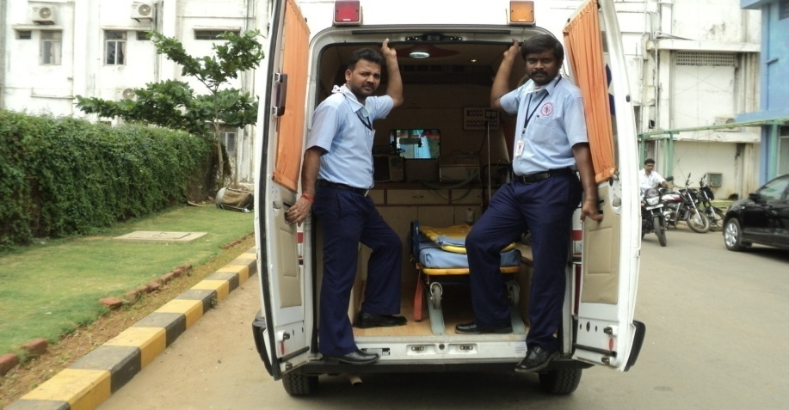
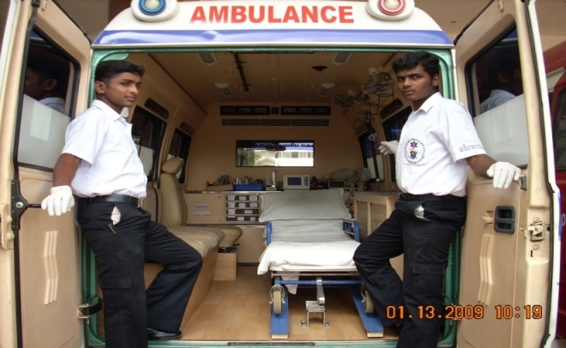
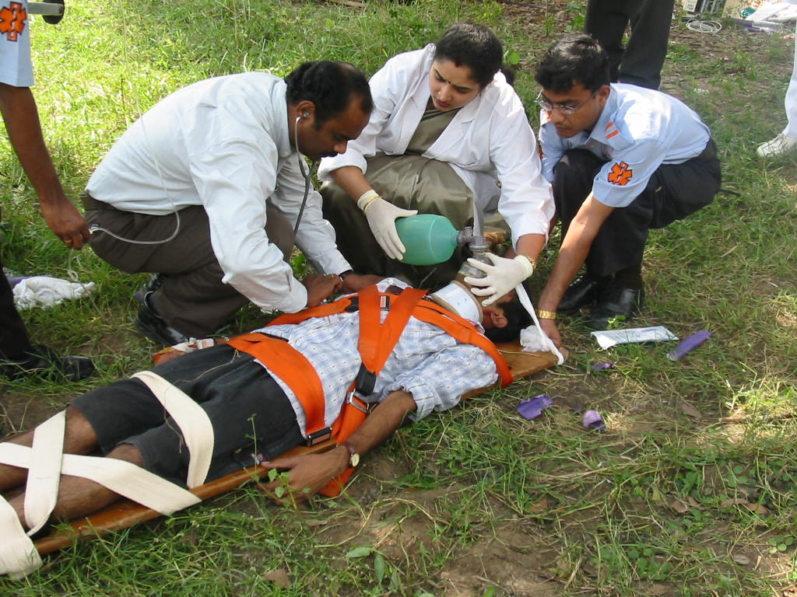
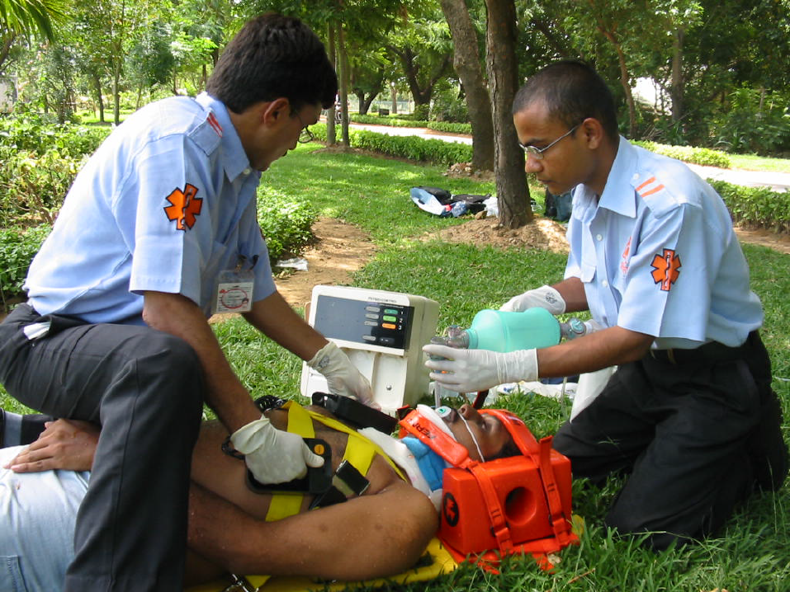
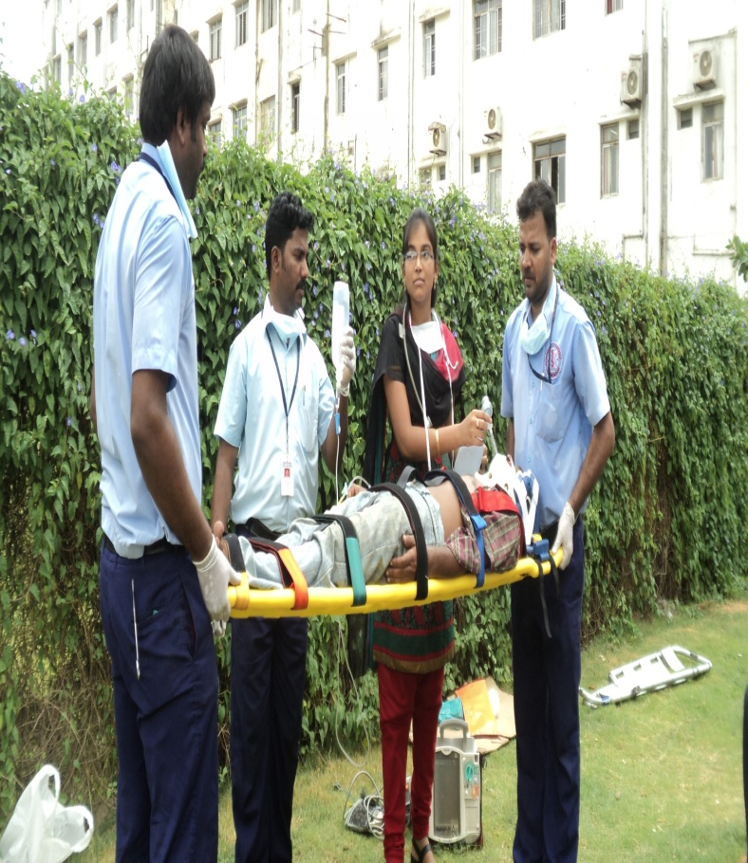
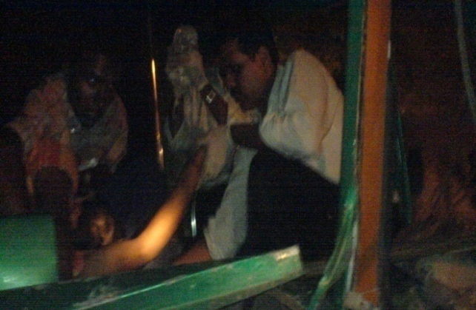
Pre-hospital Care
EMD(NMC)

Slide 6
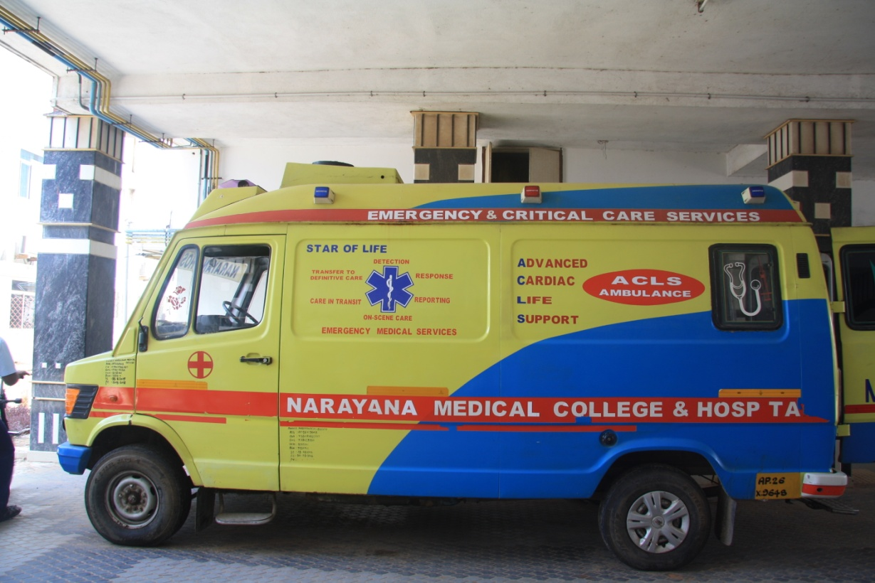
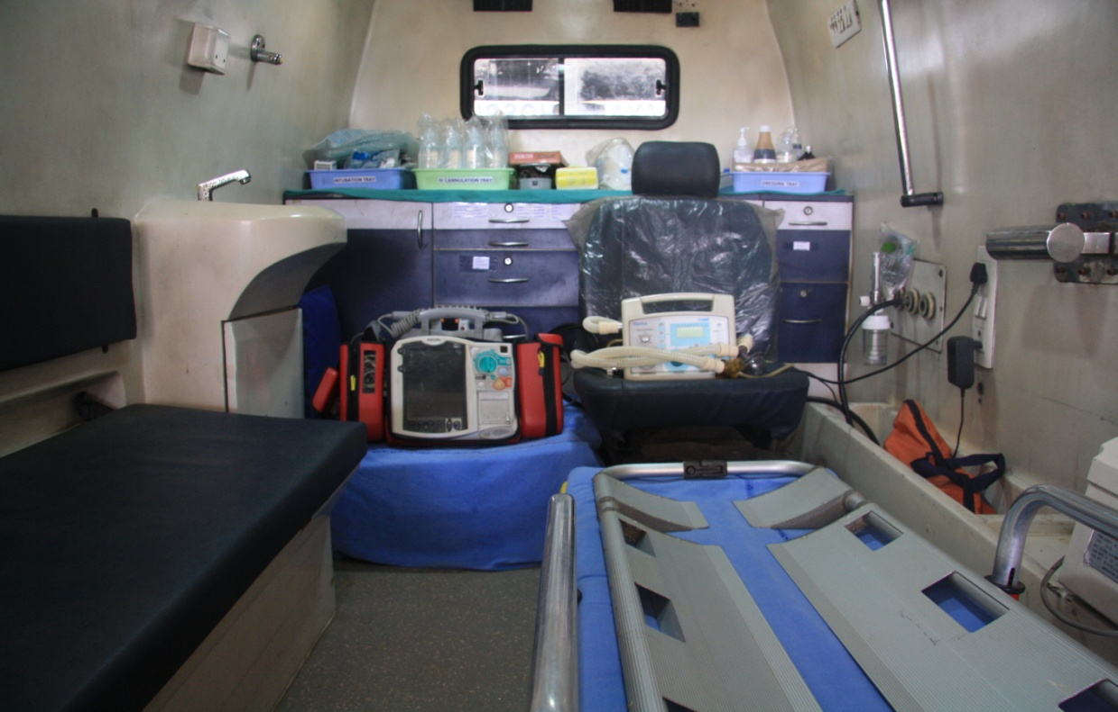
FULLY EPIQQUED
AMBULANCE

Slide 7
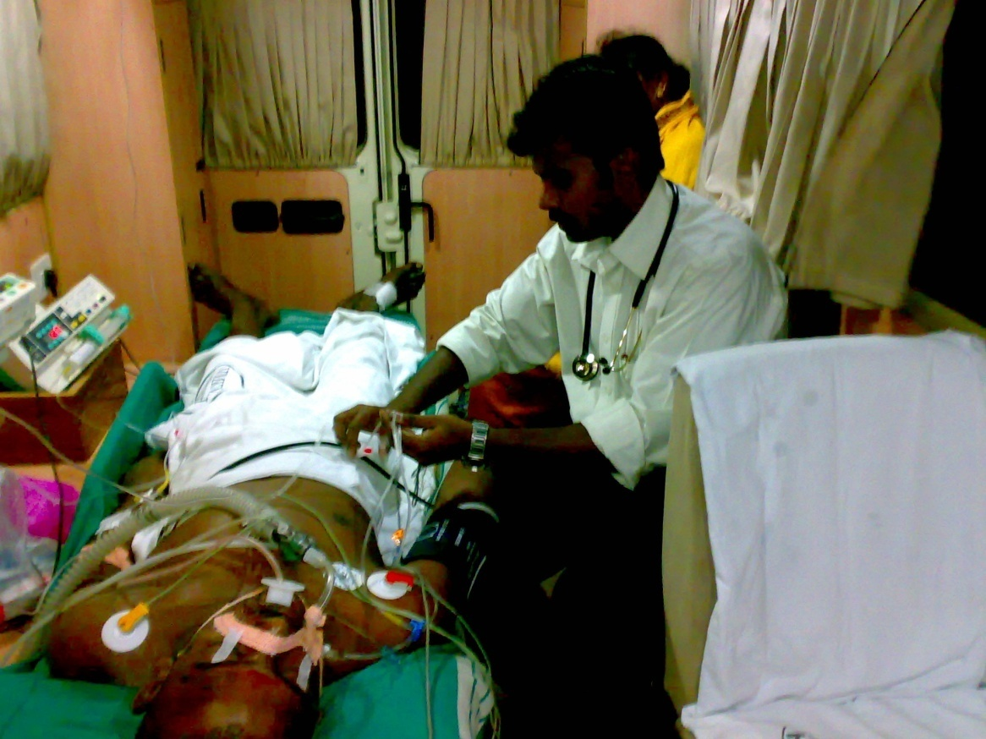
Care from the street to ED
EMD(NMC)

Slide 8
Triage
Triage: A triage system is the basic structure in which all incoming patients are categorized into groups using a standard urgency rating scale or structure.
Triage system: The process by which a clinician assesses a patient’s clinical urgency.
Re-Triage: Clinical status is a dynamic state for all patients.
Reverse Triage

Slide 9
Purpose of a triage system: To ensure that the level and quality of care that is delivered to the community is commensurate with objective clinical criteria, rather than administrative or organizational need. Facilitates quality improvement in ED’s.
A single entry point for all incoming patients (ambulant and non-ambulant), so that all patients are subjected to the same assessment process.

Slide 10
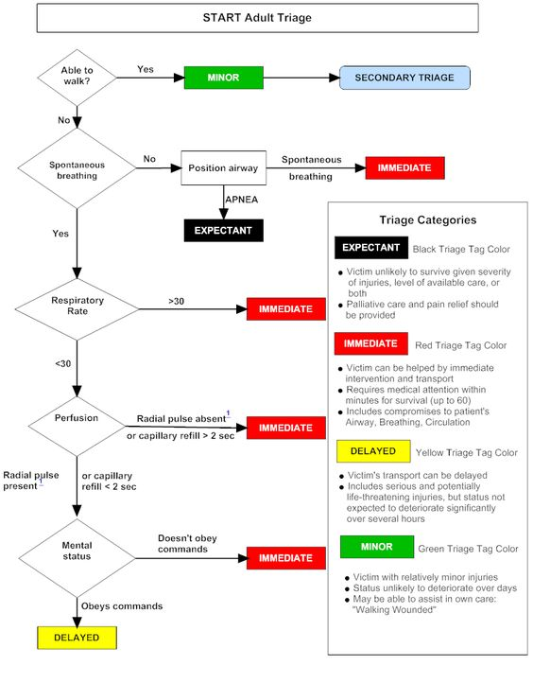

Slide 11
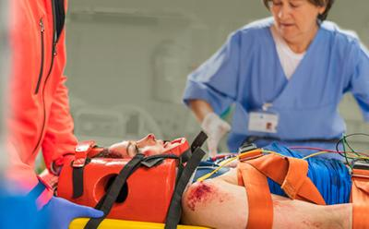
Prehospital Care
RAPID TRIAGE
Prehospital transfusion
STABILIZATION
HEMOSTATIC DRESSINGS
TRANSPORT
GOLDEN HOUR
AIRWAY&BREATHING , CIRCULATION
TRANEXAMIC ACID
TEMPERATURE MANAGEMENT
TORNIQUET USE
Advanced resuscitative skills

Slide 12
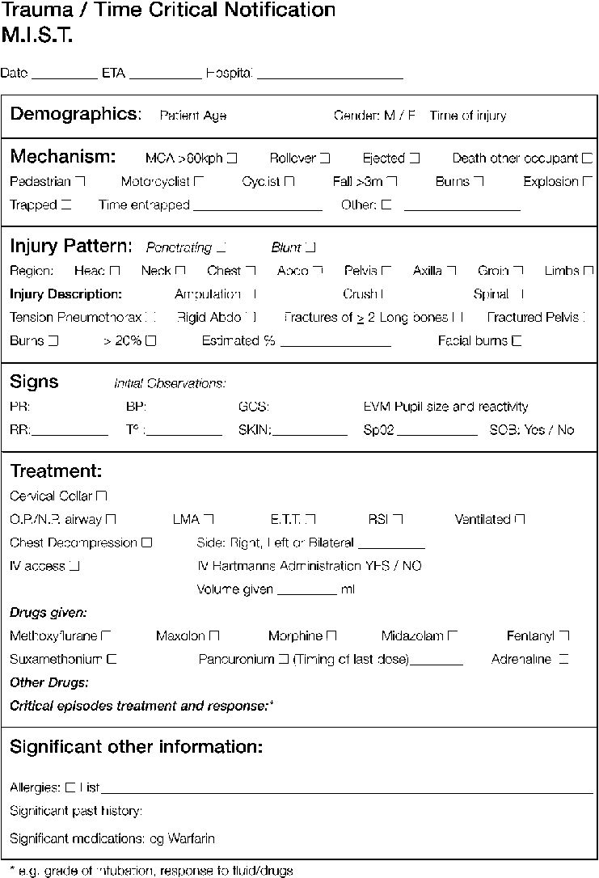
Pre hospital TRIAGE form

Slide 13
Four ”Gold Standard" Time Intervals
Event onset to start of CPR
Event onset to First Defibrillation
Event onset to Advanced Airway Management
Event onset to first administration of Resuscitation Medication
Notes:
Four "gold standard" time intervals
Another change we made was to collect data on four critical time intervals. We modified our forms to include four time intervals that the Utstein guidelines identify as gold standard variables:⁴
• Event onset to start of CPR—the time lapsed between reaching the patient and starting CPR. We expect this time to be less than 30 seconds. (Our form lists the word "minutes" after this interval and the other three for consistency's sake. Nurses write in the word "seconds" when applicable.)
• Event onset to first defibrillation—the time lapsed between reaching the patient and first defibrillation, if defibrillation is applicable. A time is entered only when the patient is found to be in VF or pulseless ventricular tachycardia.
• Event onset to advanced airway management—the time lapsed between reaching the patient and the start of airway management. Advanced airway management includes not just intubation, but effective bag-valve-mask ventilation.
• Event onset to first administration of resuscitation medication—the time lapsed between reaching the patient and administering the first drug.
If any of the intervals do not apply to a specific patient, "N/A" is entered in the corresponding space on the form to make it clear that the data is truly not applicable, and not just omitted when it should have been recorded. Many factors, including clock accuracy, affect the recording of time intervals. The Utstein guidelines recommend using the defibrillator time.⁴ Because the model of defibrillator used in our facility does not display the time on its screen, our team opted to use the wall clock located in the patient area.

Slide 14
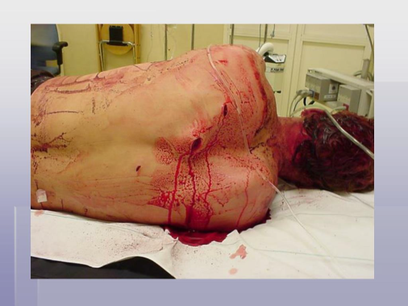
GOLDEN HOUR
Orginated By R Adams Cowley.
First sixty minutes after the occurrence multisystem trauma.
Victims chances of survival are greatest if they receive definitive care in the OR within the first hour after a severe injury.
Recently, the validity of the “golden hour” as a rigidly defined timeframe scrutinized.
Core principle of rapid intervention in trauma cases remains universally accepted.

Slide 15
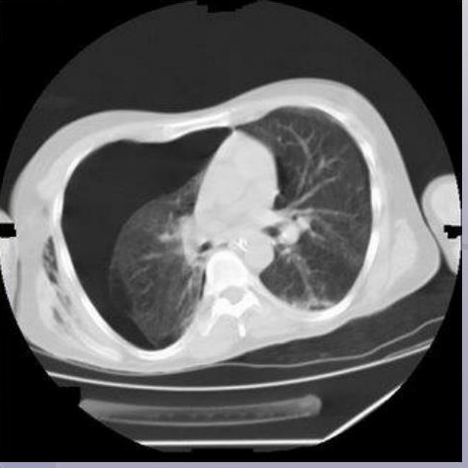
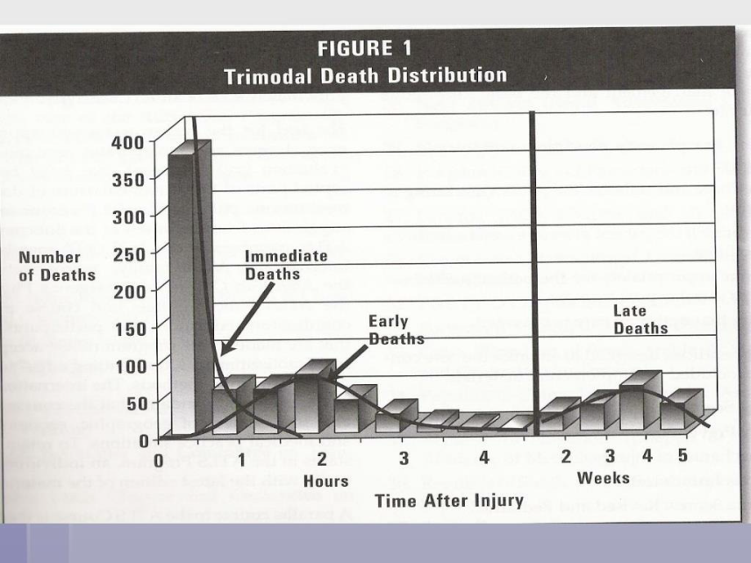
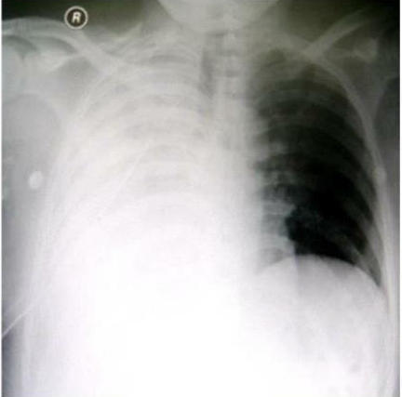
GOLDEN HOUR
“There is a golden hour between life and death. If you are critically injured you have less than 60 minutes to survive. You might not die right then; it may be three days or two weeks later-but something has happened in your body that is irreparable.”
- R Adams Cowley

Slide 16
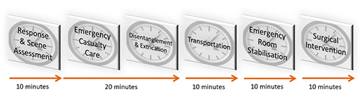
Many patients die at the scene few die after the first 24 hours following injury.
The "golden hour" concept, which emphasized the increased risk of death and the need for rapid intervention during the first hour of care following major trauma.

Slide 17
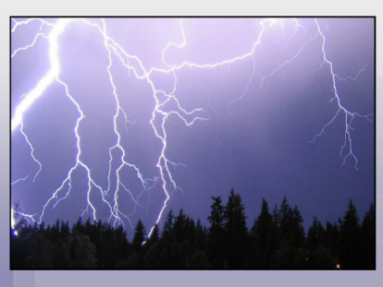
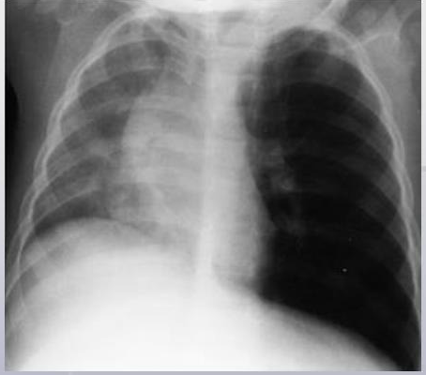
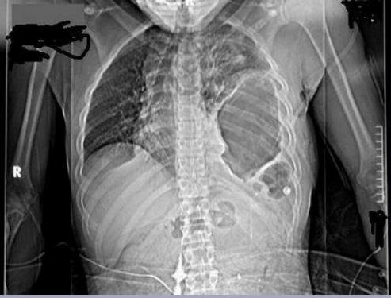
GOLDEN HOUR
Time and Trauma Outcomes
No convincing studies that time to treatment consistently leads to better outcome.
Outcome related to many factors including reduced time between injury and definitive care .
Ann Surg.2003;2372(2):153-60

Slide 18
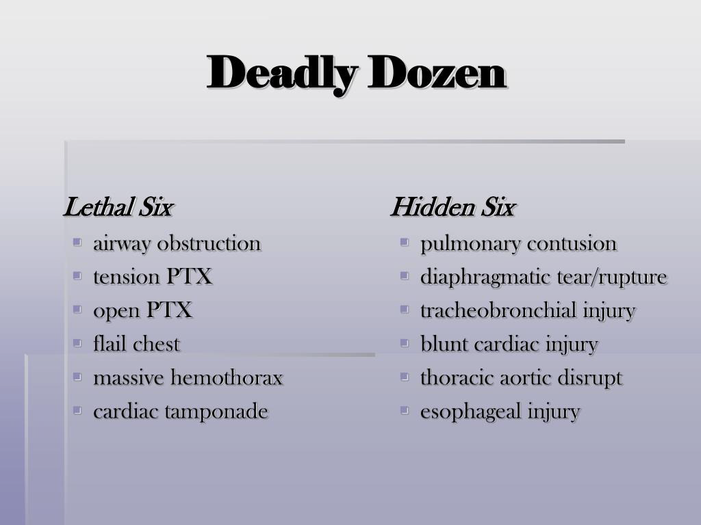
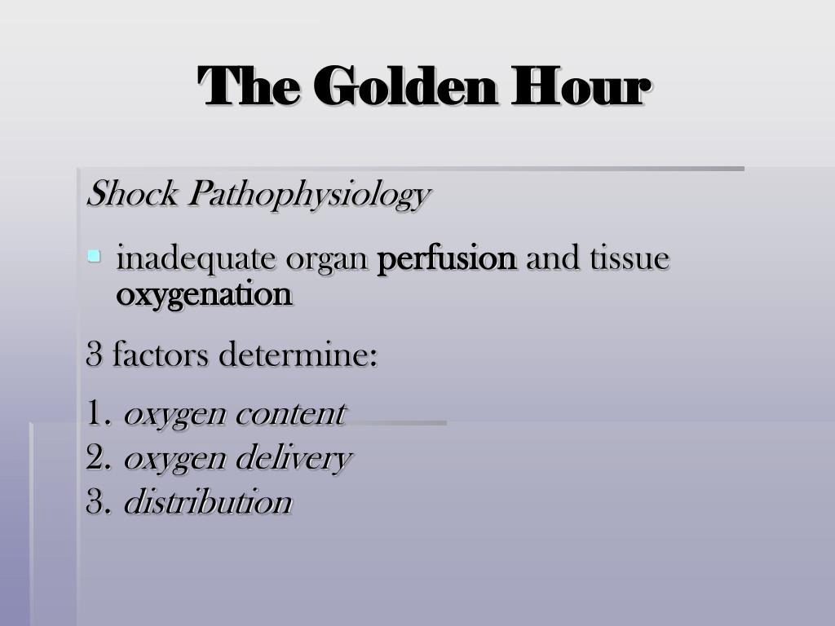
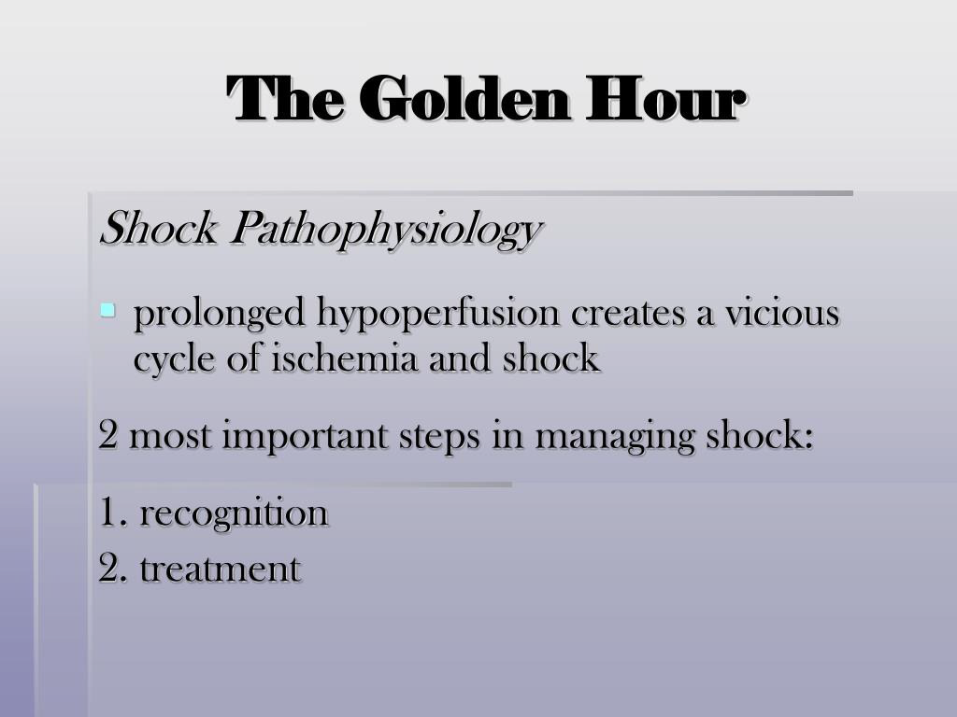
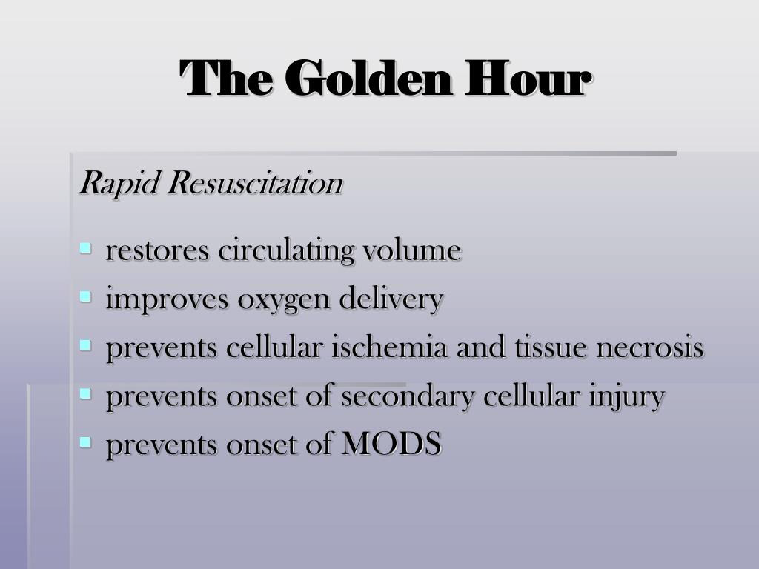
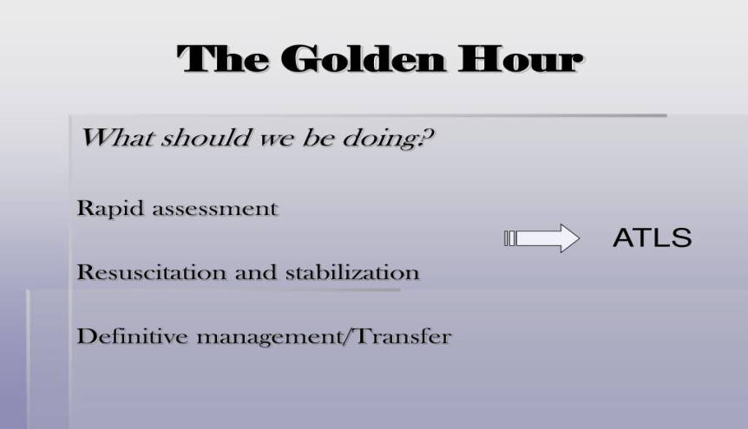

Slide 19
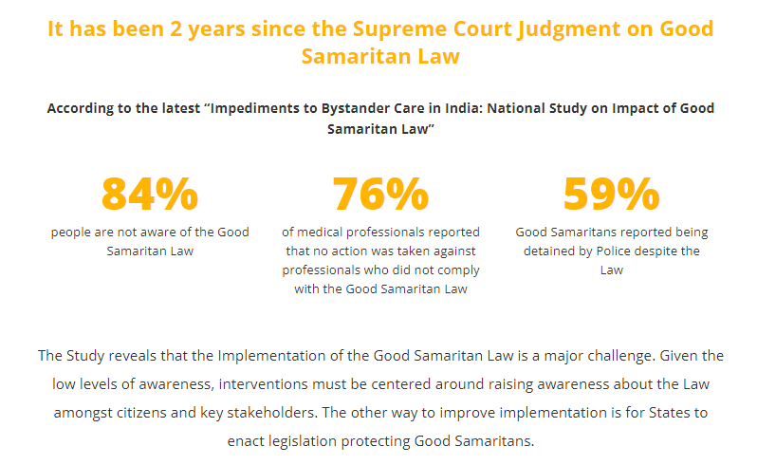
Good Samaritan Law

Slide 20
Trauma team
The major trauma team relies on an efficient, communicative team ,
For a comprehensive handover, rapid systematic review, and early management of life- and limb-threatening injuries.
The importance of team work, communication, senior decision-making, and documentation cannot be underestimated.

Slide 21
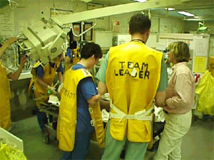
Trauma team
The trauma team must function as a unit with effective leadership and a clear understanding by team members of their roles.
Repeated briefing and review maintains clinical through the numerous transitions involved in the care of trauma patients.
During intra-operative care, the patient's status should be reviewed every 10–30 minutes and the surgical plan modified if necessary.

Slide 22
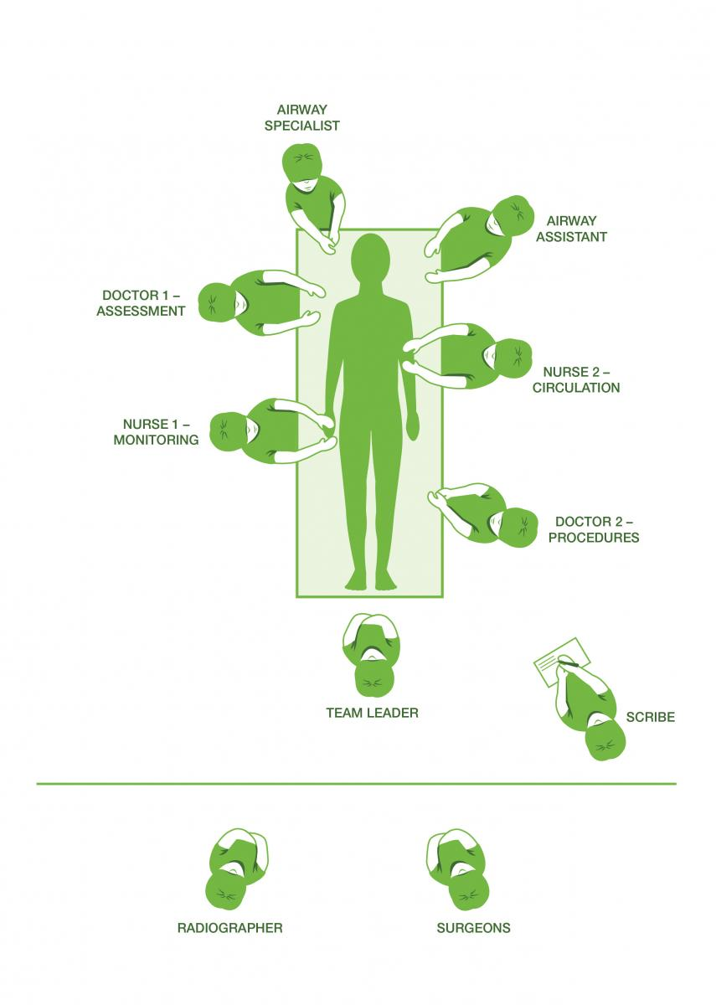
TRAUMA TEAM
It usually comprises emergency department (ED) physicians, anaesthetists, general and orthopaedic surgeons, with some units providing a radiologist, neurosurgeon, and intensive care physician.
non-technical skills. These have been described for anaesthetists by the Anaesthetic Non-Technical Skills (ANTS) system. The four skill categories described are
task management,
team working,
situation awareness,
and decision-making

Slide 23
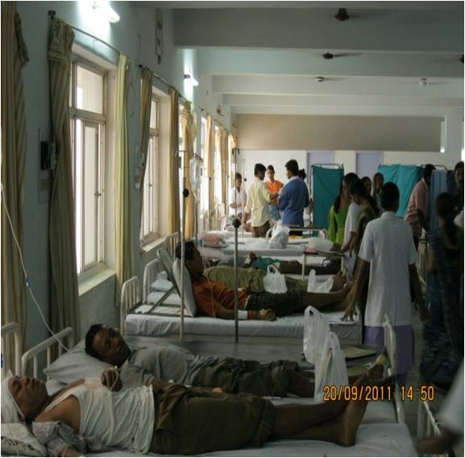
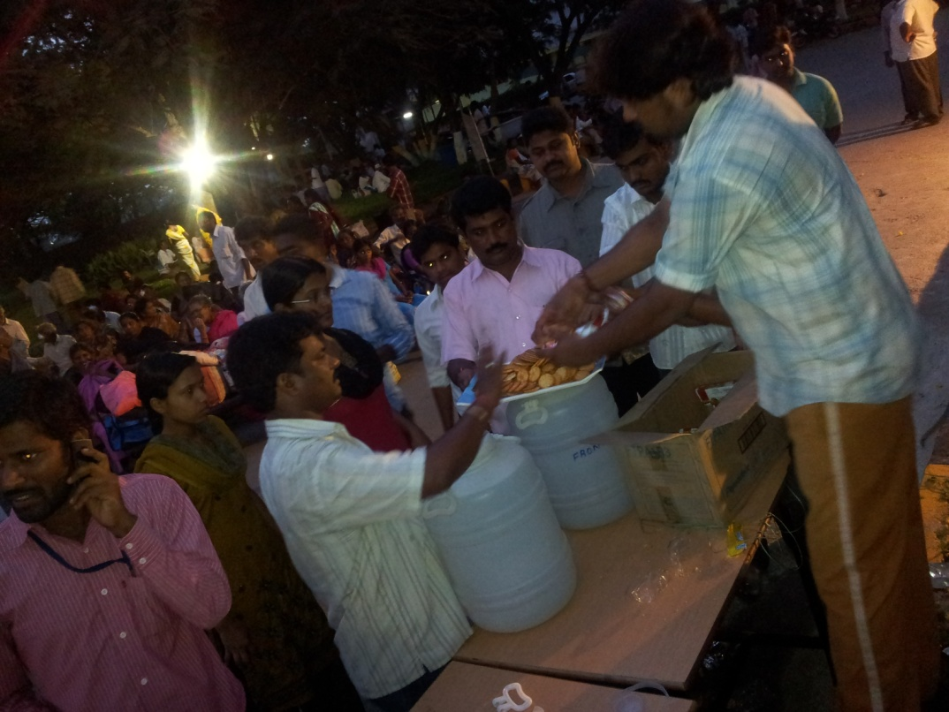
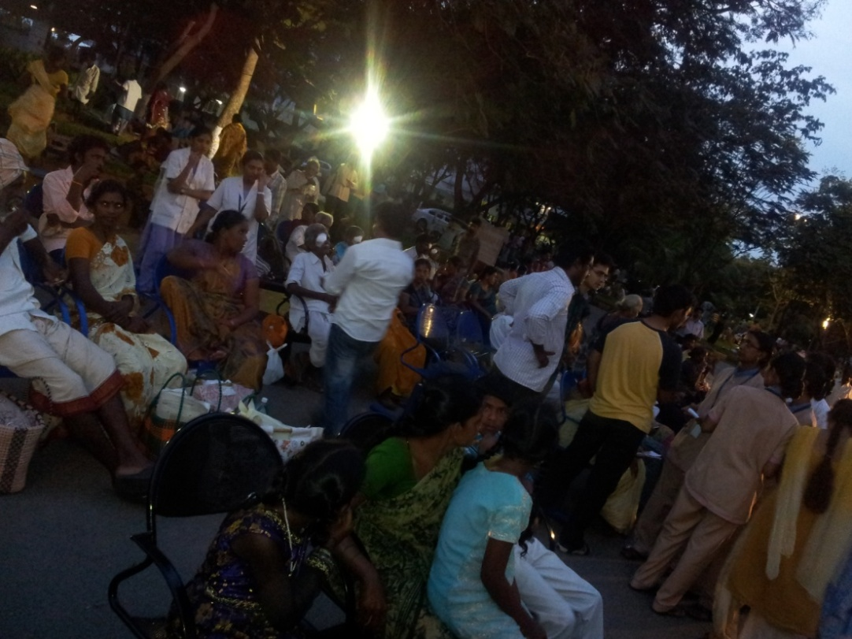
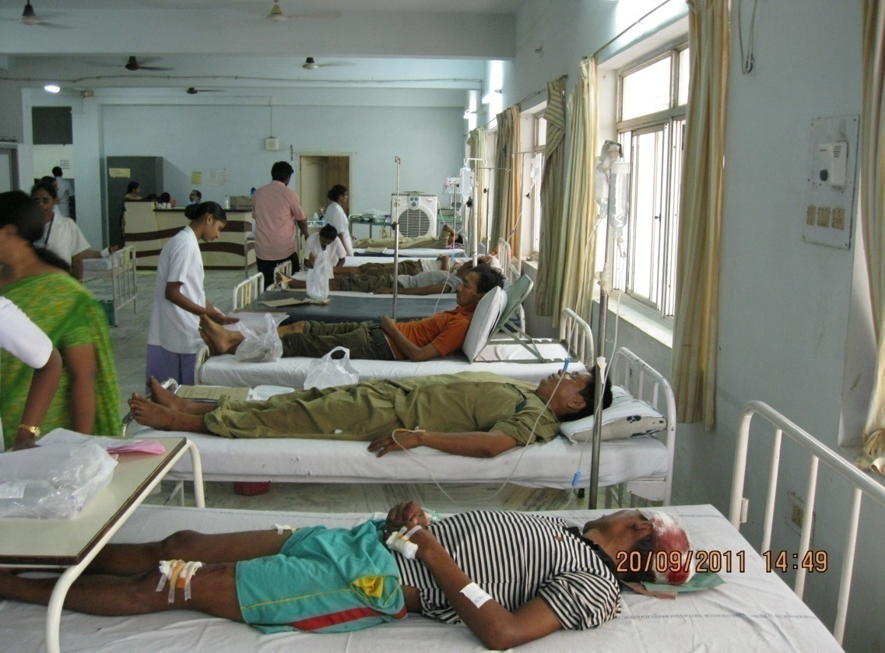
MASS CASUALITIES

Slide 24
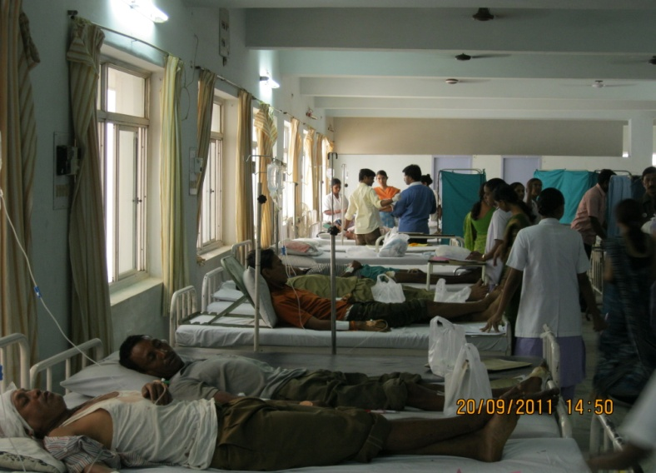
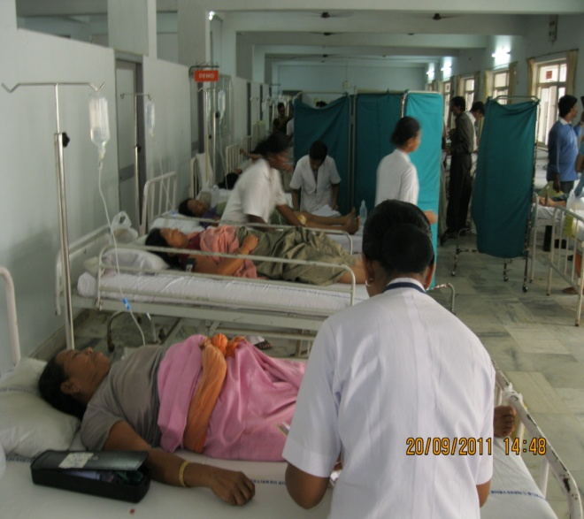
Multiple Casualties

Slide 25
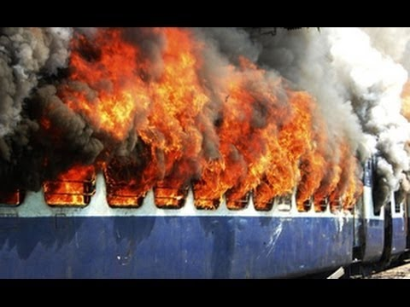
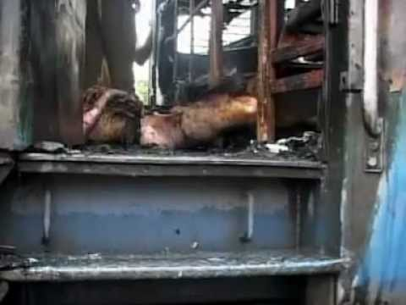
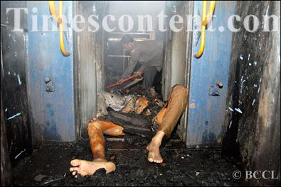
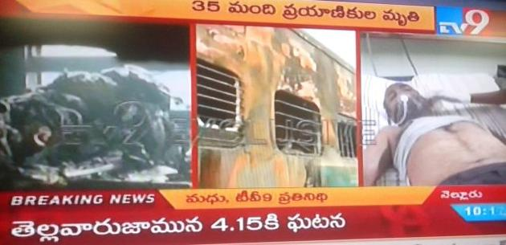
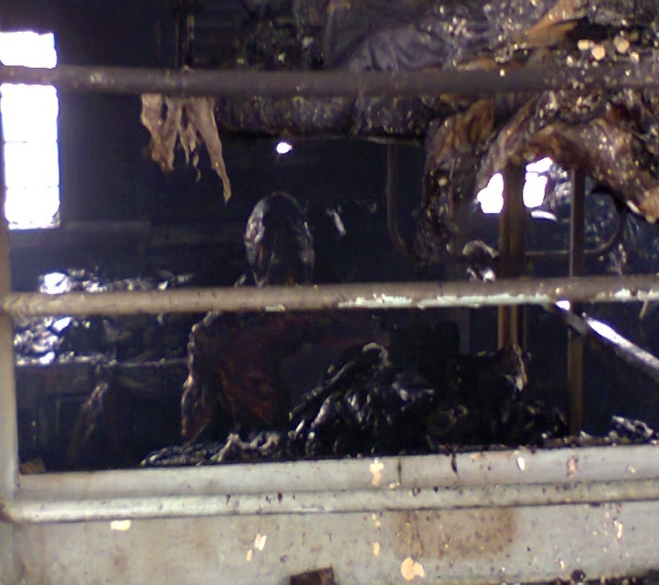
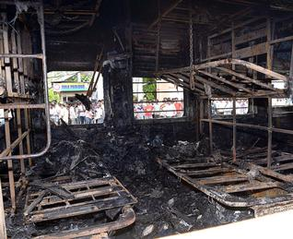
NELLORE TRAIN FIRE ACCIDENT

Slide 26

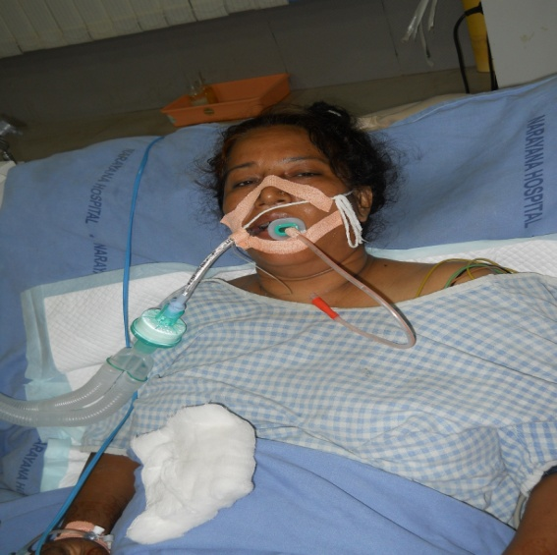
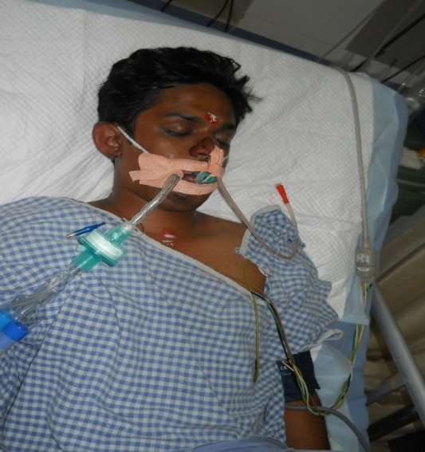
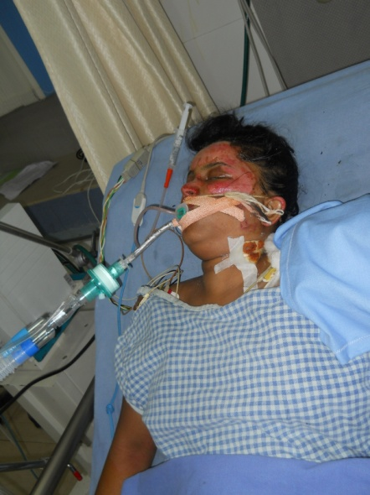
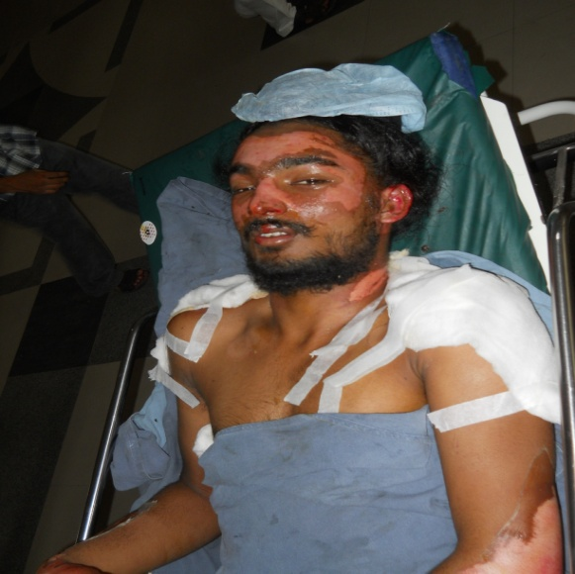
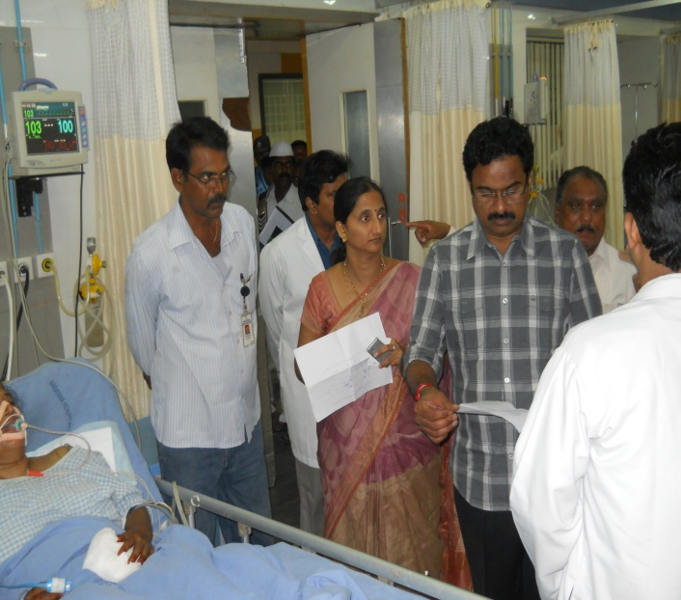
NELLORE TRAIN FIRE MISHAP VICTIMS

Slide 27

TRANSPORT
“Golden hour”
EMERGENCY
DEPARTMENT
PREPARATION
Prehospital notification and telemetry
Multidisciplinary team, OR,OT
EMERGENCY
DEPARTMENT
EVALUATION
Primary and Secondary Surveys
Reasses

Slide 28

Useful Strategies

Slide 29


Slide 30

Stabilization

Slide 31

TORNIQUET

Slide 32
Primary assesment
Re assess
Adjuncts to primary assesment
SAMPLE history
Secondary assesment
Special situations

Slide 33
Primary Assesment
Airway with SMR
Breathing
Circulation with Hemorrhage control
Disability with neurological status assesment
Exposure(undress) with Environment(temperature) control

Slide 34

Airway
Airway patency is critical in the trauma patient.
Airway maneuvers
Approach to difficult airway
RSI in trauma – how different it is
Preparation for post intubation hypotension must be made prior to the intubation,
(RSI)
Rocuronium 1 -2 mg/kg,Succinylcholine-2mg/kg

Slide 35




Slide 36

Useful Strategies

Slide 37


Slide 38


Slide 39

Breathing
Clinical evaluation
POCUS – E FAST
Tension pneumothorax orhemothorax,tamponade
Titration of the fraction of inspired oxygen (FiO²) is critical, as hyperoxygenation is associated with increased mortality in the critically ill.

Slide 40
Circulation
Fluid Resuscitation :Key issues are when to trigger the massive transfusion protocol (MTP), how to utilize the various blood components and adjuncts, and what ratio to use for blood products, use 2 wide bore cannulas
Military guidelines suggest the choice of initial resuscitative fluid should be whole blood, component therapy with a balanced 1:1:1 ratio, red blood cells (RBCs) and plasma in 1:1 ratio, then very limited use of crystalloids.
Massive Transfusion
include packed red blood cells (pRBCs), plasma, platelets, cryoprecipitate or fibrinogen concentrate, and other adjuncts such as calcium, tranexamic acid, and possibly prothrombin complex concentrate (PCC).

Slide 41



Slide 42



Slide 43



Slide 44


Useful Strategies

Slide 45


The Lethal Triad

Slide 46
Treatment
Balanced resuscitation and permissive hypotension, DCR .
“ABCDE” primary survey advocated by ATLS.
Exsanguinating hemorrhage should be addressed first.
Hemorrhage Control With In-Hospital Hemostatic Devices :
Tourniquet duration of 60 minutes or longer was not associated with increased amputations but was associated with more incidences of rhabdomyolysis.
Suspected open-book pelvic fractures may be treated initially with pelvic binding to facilitate tamponade prior to surgical packing, angioembolization, and/or external fixation.

Slide 47
DAMAGE CONTROL RESUSCITATION
The key components of DCR are:
Time limited permissive hypotension,
Massive Haemorrhage Protocols,
Tranexamic acid, and
Damage Control Surgery (DCS).

Slide 48



Slide 49



Slide 50
Resuscitative Endovascular Balloon Occlusion of the Aorta
Much-discussed adjunct for the control of noncompressible torso injuries .
With exsanguinating hemorrhage from abdominal trauma, surgical control of the bleeding by initial rapid aortic clamping is a lifesaving, but highly morbid procedure.
REBOA attempts to achieve the same effect by endovascularly occluding blood flow through the aorta temporarily.
Main indications for REBOA have been life-threatening hemorrhage and hemorrhagic shock originating solely from a source below the diaphragm, without traumatic arrest. Inflation in Zone I (origin of the left subclavian to ) for control of severe intra-abdominal or retroperitoneal hemorrhage is indicated only if the anticipated time to operation is < 15 minutes.

Slide 51
Inflation in Zone III (lowest renal artery to the aortic bifurcation) is indicated for severe pelvic, junctional, or proximal lower extremity hemorrhage.
Adverse effects of REBOA include progressive distal ischemia, amputation, kidney injury, arterial injury, supraphysiologic pressures, and a related increase in cardiac afterload.

Slide 52



SUBCLAVIAN
COLEIAC
RENAL
FEMORAL
Zone III should be reserved for only relatively stable patients with ongoing distal hemorrhage.

Slide 53
Cardiac Arrest
Cardiac arrest in trauma patients is physiologically different from medical cardiac arrest.
Compromised rib cage limits recoil-driven venous return and hypovolemia limits stroke volume, all while the repetitive compressions in CPR disrupt low-flow-driven hemostasis.
Survival rate was 17% if it was performed in-hospital;

Slide 54
Resuscitative Thoracotomy
The 2012 WTA guidelines specify acceptable CPR times in penetrating trauma (15 minutes) or blunt trauma (10 minutes) before performing resuscitative thoracotomy.
A 5-year retrospective review indicated that resuscitative thoracotomy is futile in patients aged > 60 years with blunt trauma or any patient aged ≥ 70 years.

Slide 55


Slide 56


Slide 57




Slide 58


Slide 59
Adjuncts
ECG
ABG
CXR
POCUS
Hb
Blood grouping and Rh typing
TEG

Slide 60


Slide 61

Early Warning Score
Notes:
EWSNew control
0 Within 24 hours
1 Within 8–12 hours
2 Within 4–8 hours
3 Within 1–2 hours
≥4 Contact with mobile intensive care team

Slide 62

SPECIAL SITUATIONS

Slide 63

Teaching Documentation In Emergency Setup

Slide 64


DOCUMENTATION

Slide 65





Slide 66
CARDIAC ARREST RHTHYMS
ASYSTOLE-FLAT LINE PROTOCOL
PULSE LESS ELECTRICAL ACTIVITY-PEA
VENTRICULAR FIBRILLATION –VF
VENTRICULAR TACHYCARDIA-VT

Slide 67


Slide 68


NON SHOCKABLE RHYTHMS
PEA
H’s/T’s
ASYSTOLE

Slide 69


SHOCKABLE RHYTHMS
VF
VT

Slide 70


Slide 71


Slide 72

POSITIONS FOR 6-PERSON HIGH-PERFORMANCE TEAMS

Slide 73


Slide 74


Slide 75


Slide 76


Slide 77


Slide 78


Slide 79


Slide 80


Slide 81


Slide 82


Slide 83


Slide 84


Slide 85

THANQ

